Slide 1
Clustering

Slide 2




In general a grouping of objects such that the objects in a group (cluster) are similar (or related) to one another and different from (or unrelated to) the objects in other groups
Inter-cluster distances are maximized
Intra-cluster distances are minimized

Slide 3
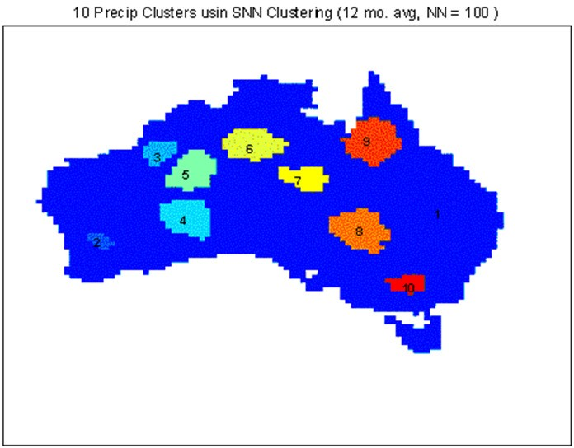
 | Discovered Clusters | Industry Group
1 | Applied-Matl-DOWN,Bay-Network-Down,3-COM-DOWN, Cabletron-Sys-DOWN,CISCO-DOWN,HP-DOWN, DSC-Comm-DOWN,INTEL-DOWN,LSI-Logic-DOWN, Micron-Tech-DOWN,Texas-Inst-Down,Tellabs-Inc-Down, Natl-Semiconduct-DOWN,Oracl-DOWN,SGI-DOWN, Sun-DOWN | Technology1-DOWN
2 | Apple-Comp-DOWN,Autodesk-DOWN,DEC-DOWN, ADV-Micro-Device-DOWN,Andrew-Corp-DOWN, Computer-Assoc-DOWN,Circuit-City-DOWN, Compaq-DOWN, EMC-Corp-DOWN, Gen-Inst-DOWN, Motorola-DOWN,Microsoft-DOWN,Scientific-Atl-DOWN | Technology2-DOWN
3 | Fannie-Mae-DOWN,Fed-Home-Loan-DOWN, MBNA-Corp-DOWN,Morgan-Stanley-DOWN | Financial-DOWN
4 | Baker-Hughes-UP,Dresser-Inds-UP,Halliburton-HLD-UP, Louisiana-Land-UP,Phillips-Petro-UP,Unocal-UP, Schlumberger-UP | Oil-UP
Understanding
Group related documents for browsing, group genes and proteins that have similar functionality, or group stocks with similar price fluctuations
Summarization
Reduce the size of large data sets
Clustering precipitation in Australia
Notes:
precipitation英 [prɪˌsɪpɪˈteɪʃn] 美 [prɪˌsɪpɪˈteʃən] n.沉淀;匆促;（雨等）降落;某地区降雨等的量

Slide 4
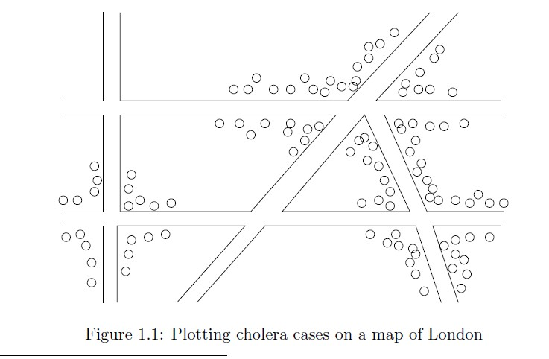
John Snow, London 1854
Notes:
cholera英 [ˈkɒlərə] 美 [ˈkɑ:lərə] n.[医]霍乱;虎疫TEM8

Slide 5

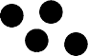

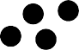



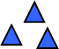
How many clusters?
Six Clusters
Two Clusters
Four Clusters

Slide 6

A clustering is a set of clusters
Important distinction between hierarchical and partitional sets of clusters
Partitional Clustering
A division data objects into subsets (clusters) such that each data object is in exactly one subset
Hierarchical clustering
A set of nested clusters organized as a hierarchical tree

Slide 7

Original Points
A Partitional Clustering

Slide 8

p1
p3
p4
p2
p1 p2 p3 p4
Traditional Dendrogram
Traditional Hierarchical Clustering
p1
p3
p4
p2
p1 p2 p3 p4
Non-traditional Dendrogram
Non-traditional Hierarchical Clustering

Slide 9
Exclusive (or non-overlapping) versus non- exclusive (or overlapping)
In non-exclusive clusterings, points may belong to multiple clusters.
Points that belong to multiple classes, or ‘border’ points
Fuzzy (or soft) versus non-fuzzy (or hard)
In fuzzy clustering, a point belongs to every cluster with some weight between 0 and 1
Weights usually must sum to 1 (often interpreted as probabilities)
Partial versus complete
In some cases, we only want to cluster some of the data

Slide 10
Well-Separated Clusters:
A cluster is a set of points such that any point in a cluster is closer (or more similar) to every other point in the cluster than to any point not in the cluster.
3 well-separated clusters

Slide 11
Center-based
A cluster is a set of objects such that an object in a cluster is closer (more similar) to the “center” of a cluster, than to the center of any other cluster
The center of a cluster is often a centroid, the minimizer of distances from all the points in the cluster, or a medoid, the most “representative” point of a cluster
4 center-based clusters

Slide 12
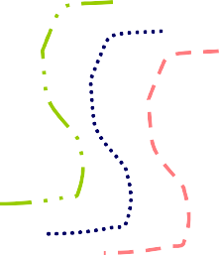
Contiguous Cluster (Nearest neighbor or Transitive)
A cluster is a set of points such that a point in a cluster is closer (or more similar) to one or more other points in the cluster than to any point not in the cluster.
8 contiguous clusters

Slide 13

Density-based
A cluster is a dense region of points, which is separated by low- density regions, from other regions of high density.
Used when the clusters are irregular or intertwined, and when noise and outliers are present.
6 density-based clusters

Slide 14
Clustering as an optimization problem
Finds clusters that minimize or maximize an objective function.
Enumerate all possible ways of dividing the points into clusters and evaluate the `goodness' of each potential set of clusters by using the given objective function. (NP Hard)
Can have global or local objectives.
Hierarchical clustering algorithms typically have local objectives
Partitional algorithms typically have global objectives
A variation of the global objective function approach is to fit the data to a parameterized model.
The parameters for the model are determined from the data, and they determine the clustering
E.g., Mixture models assume that the data is a ‘mixture' of a number of statistical distributions.

Slide 15
K-means

Slide 16
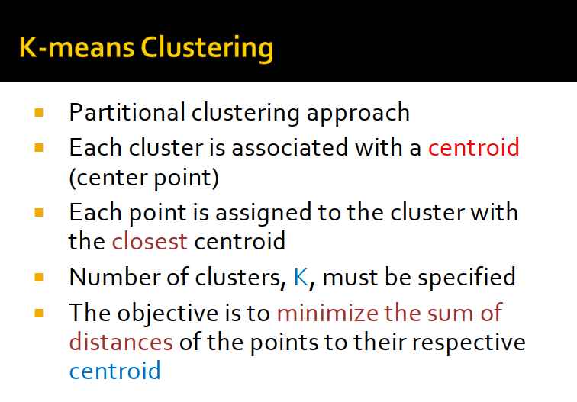

Slide 17
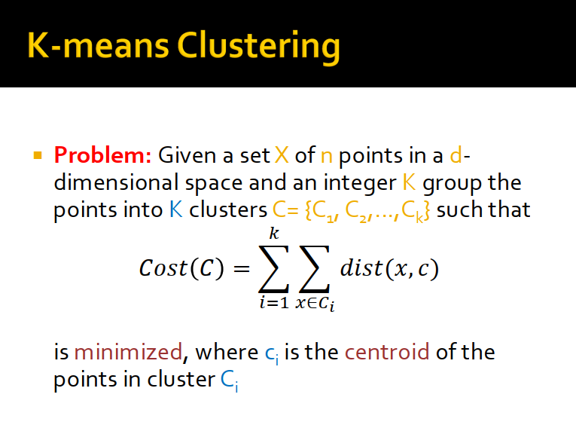

Slide 18
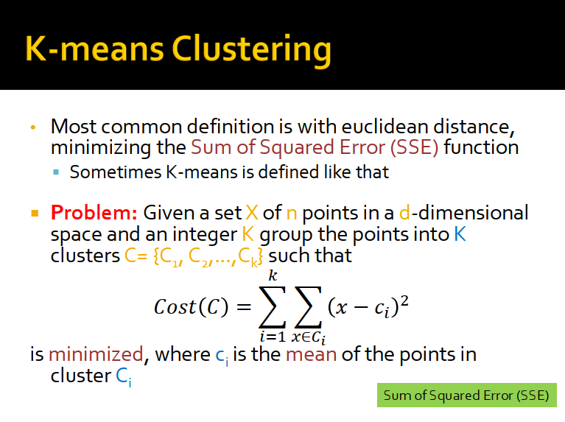

Slide 19
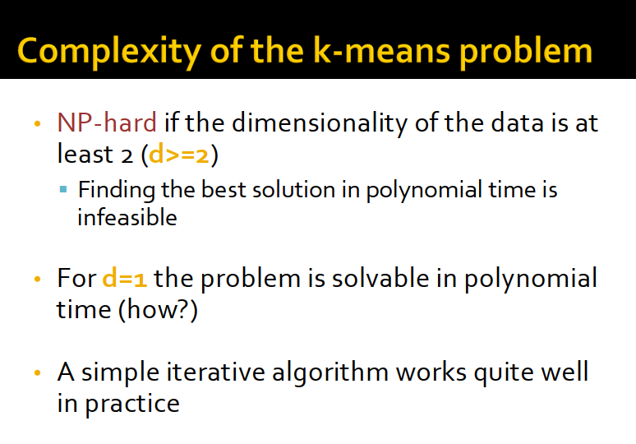

Slide 20
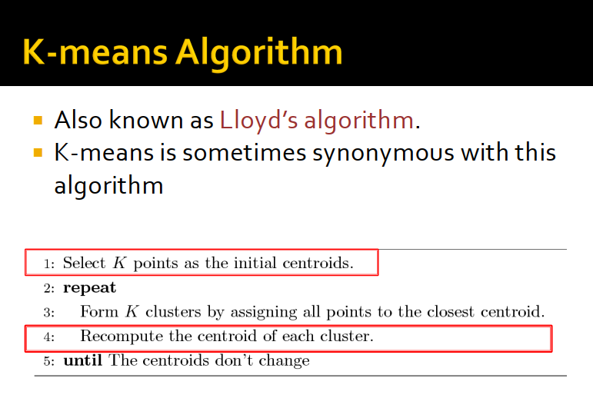

Slide 21
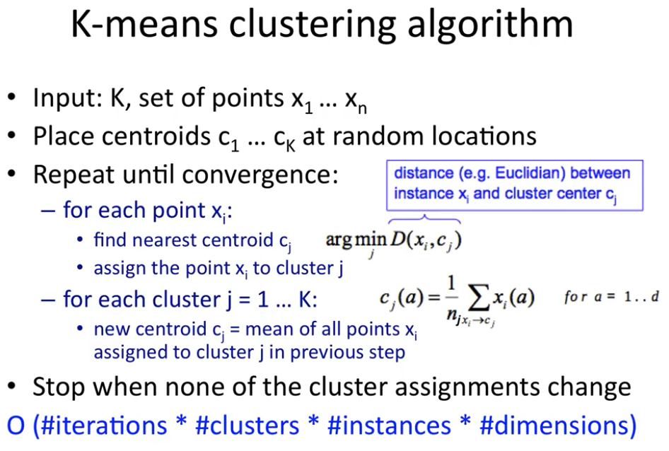

Slide 22
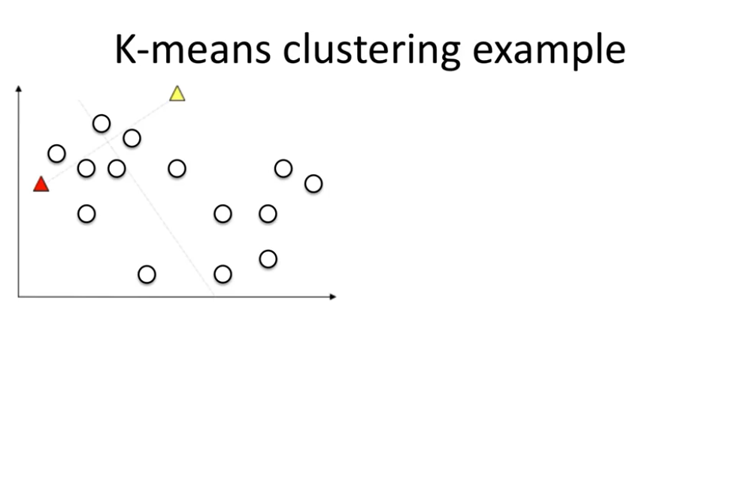

Slide 23
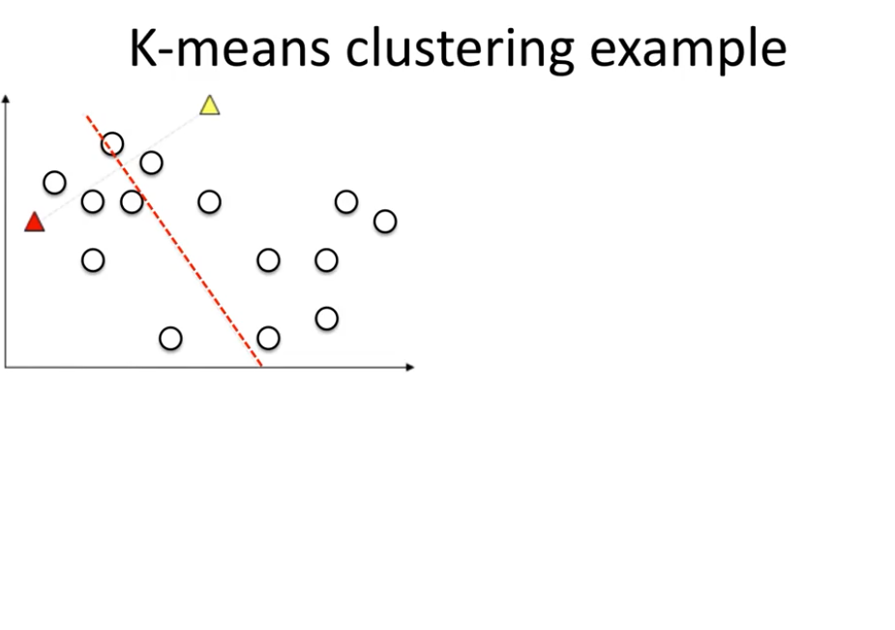

Slide 24
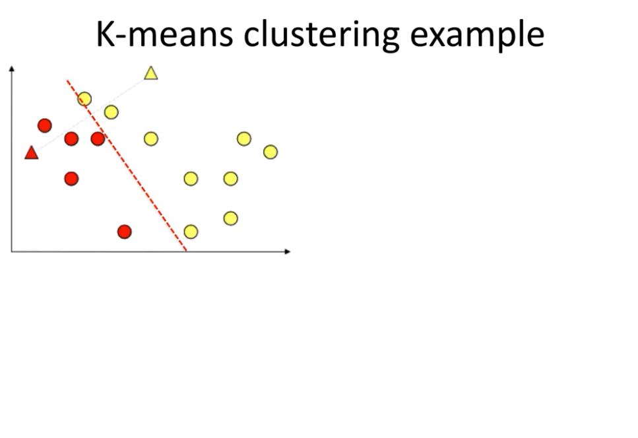

Slide 25
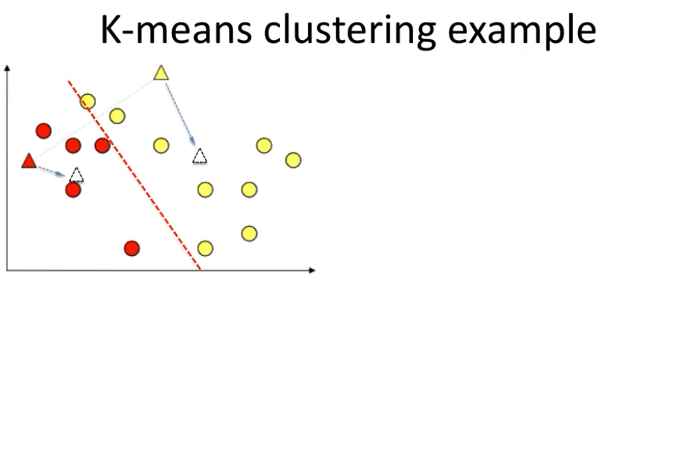

Slide 26
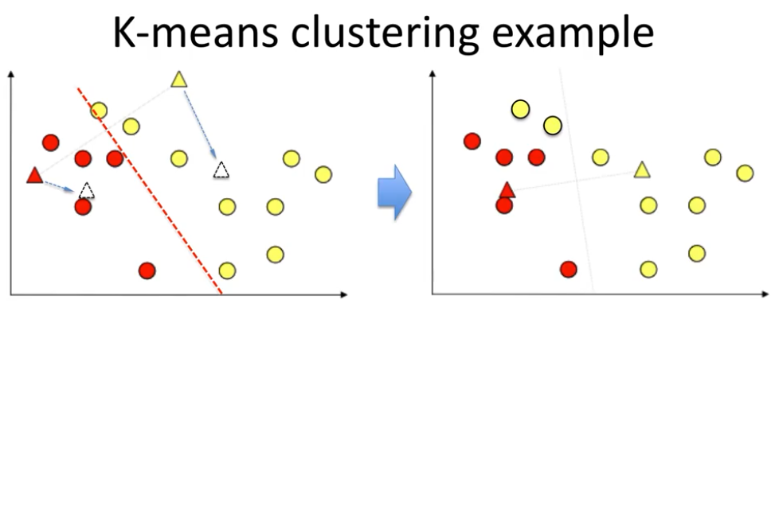

Slide 27
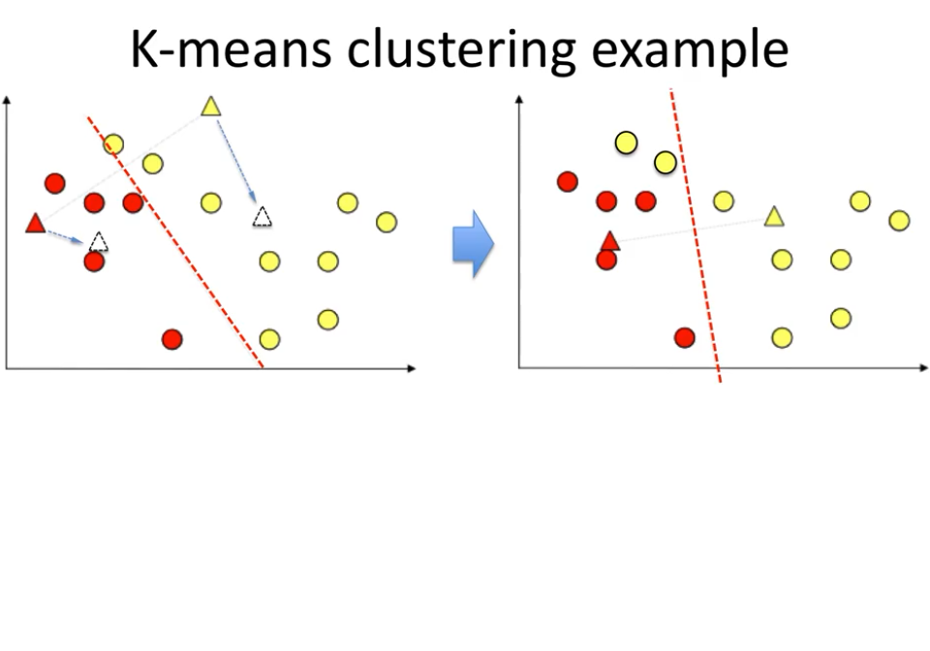

Slide 28
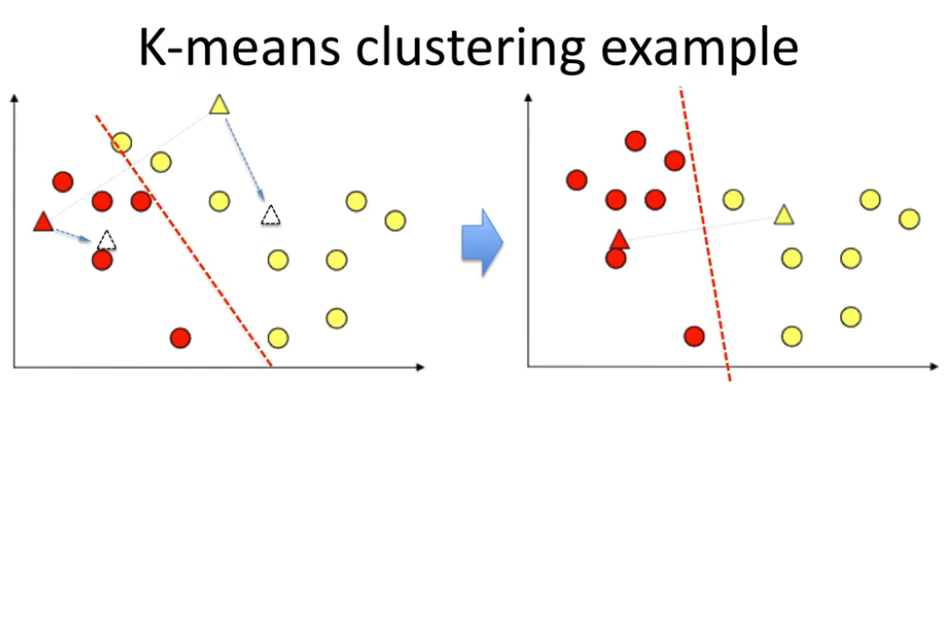

Slide 29
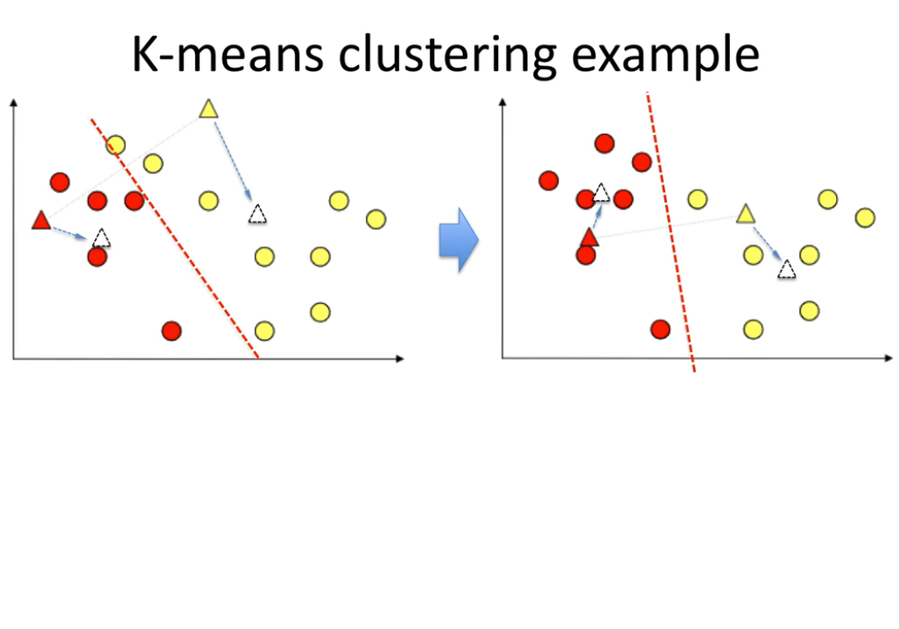

Slide 30
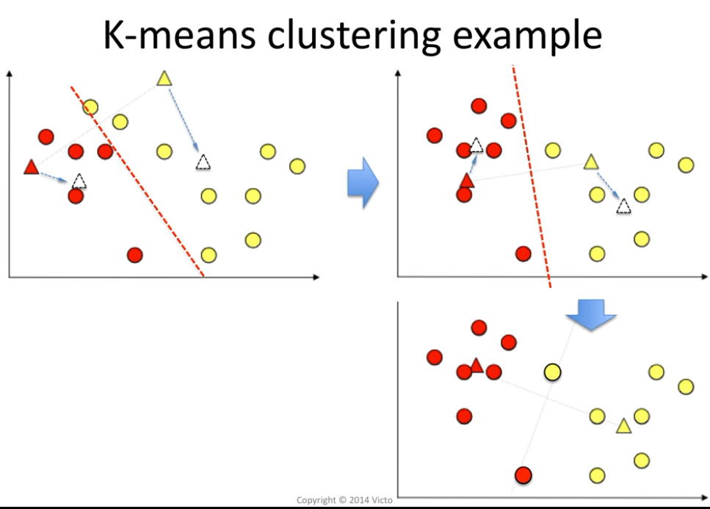

Slide 31
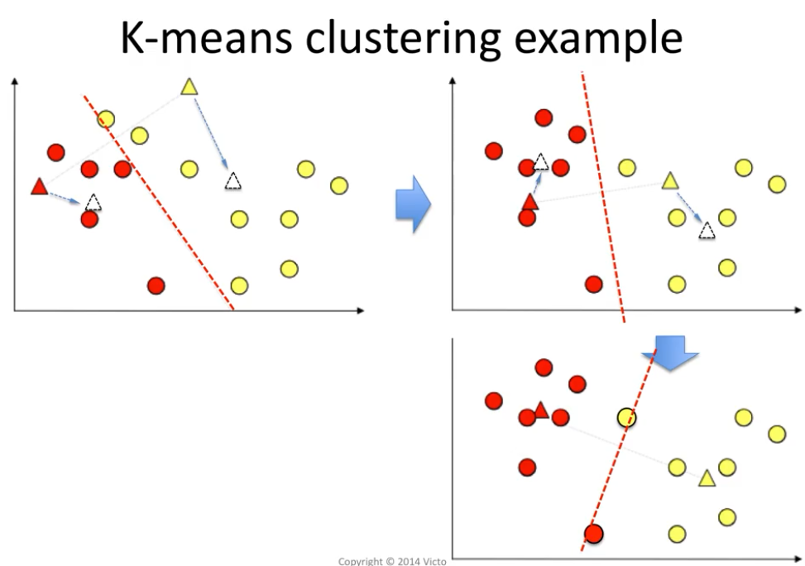

Slide 32
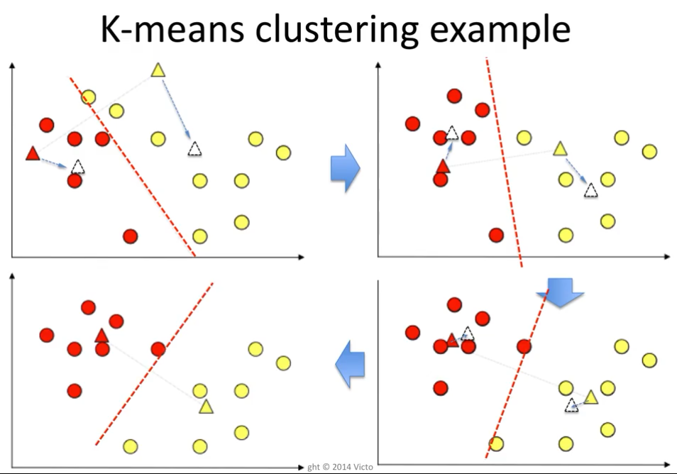

Slide 33
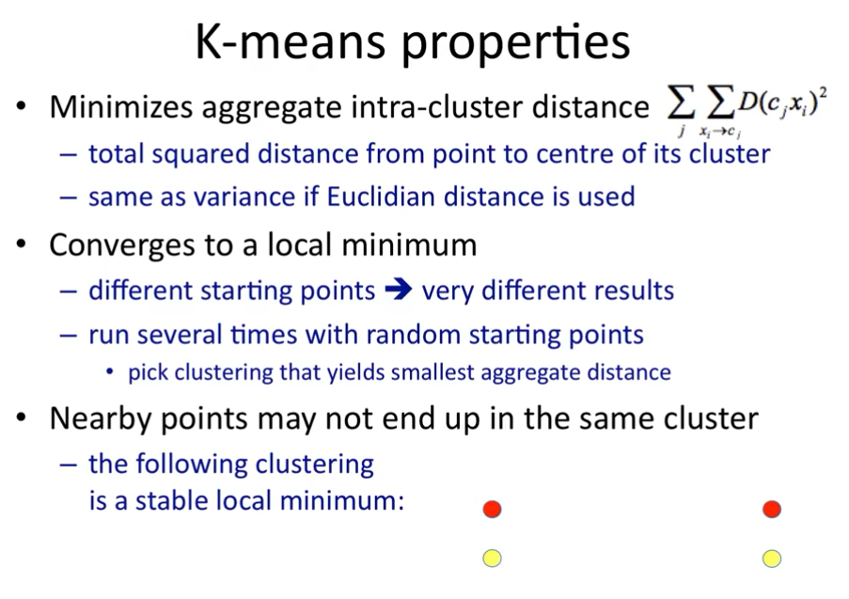

Slide 34
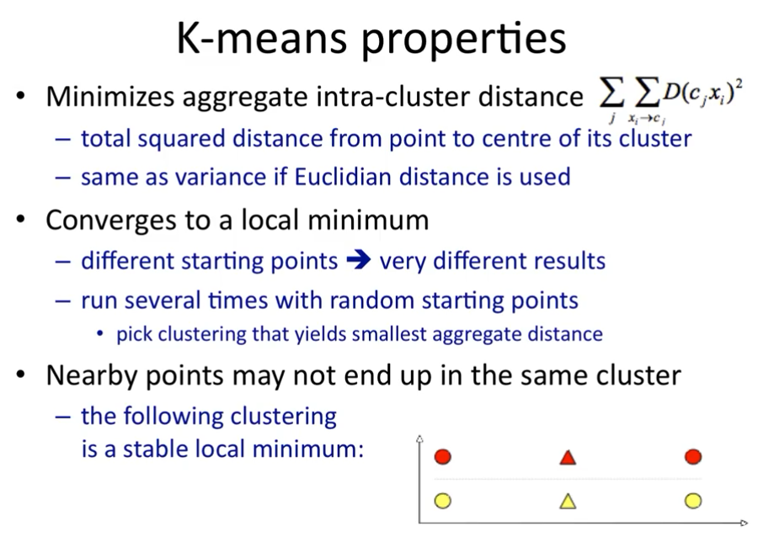

Slide 35
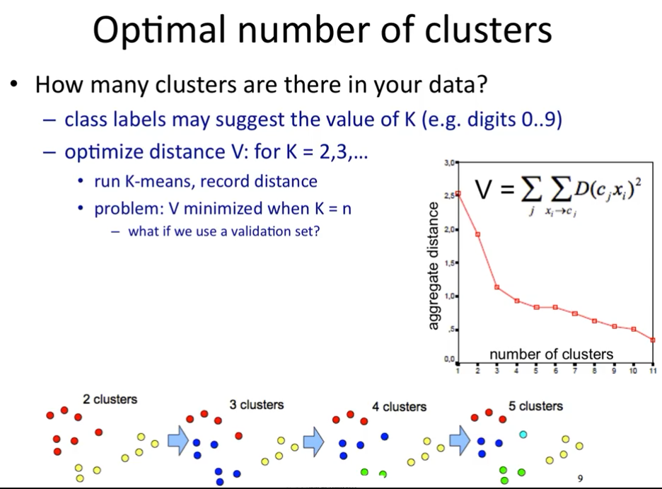

Slide 36
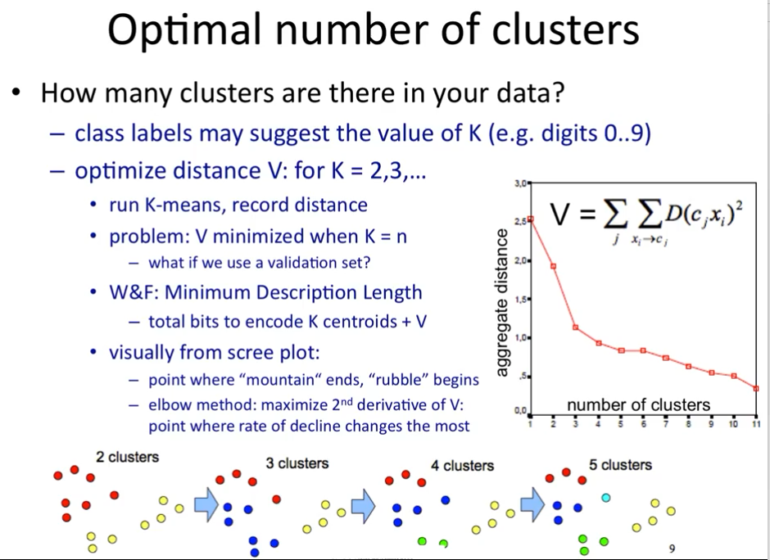
Notes:
rubble
英 [ˈrʌbl] 美 [ˈrʌbəl]
n. 碎石，瓦砾;碎砖，瓦砾;碎岩;残壁
elbow
英 [ˈelbəʊ] 美 [ˈelboʊ]
n. 肘部;弯头，扶手;肘形管，弯管
scree plot陡坡图

Slide 37
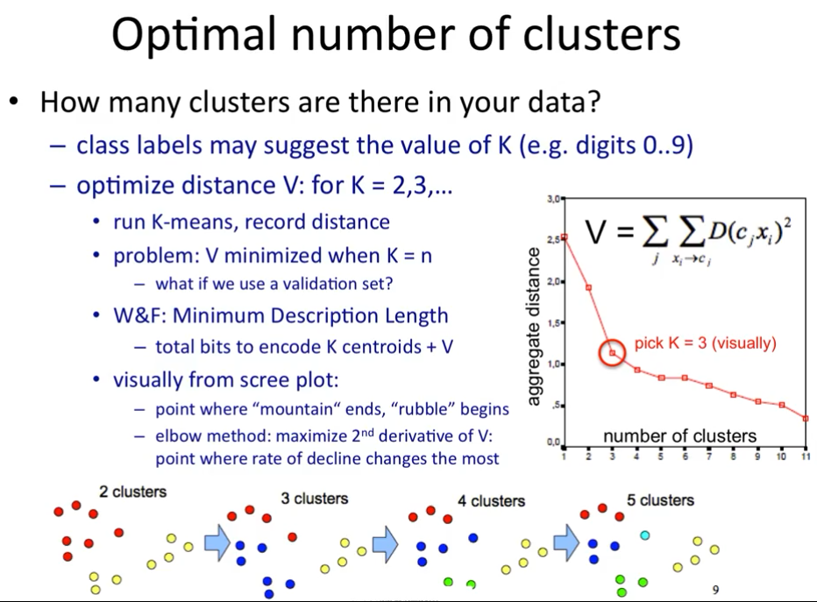

Slide 38
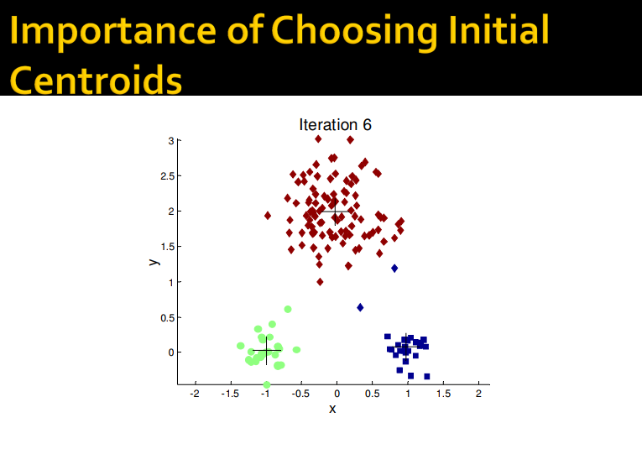

Slide 39
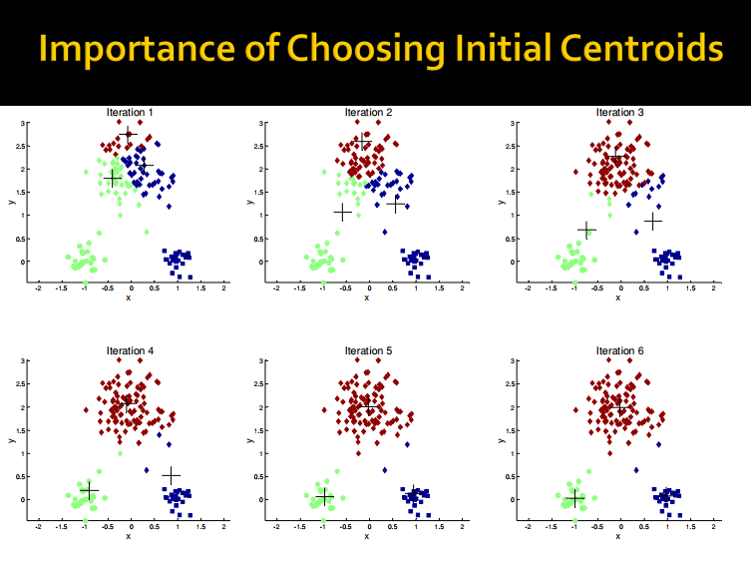

Slide 40
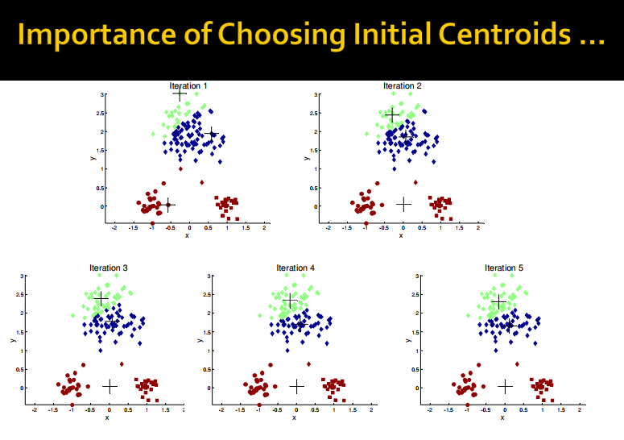

Slide 41
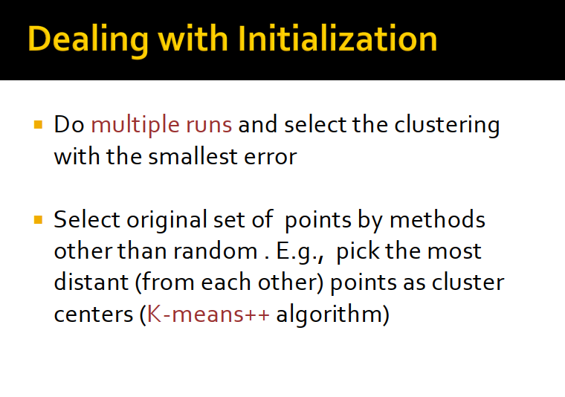

Slide 42
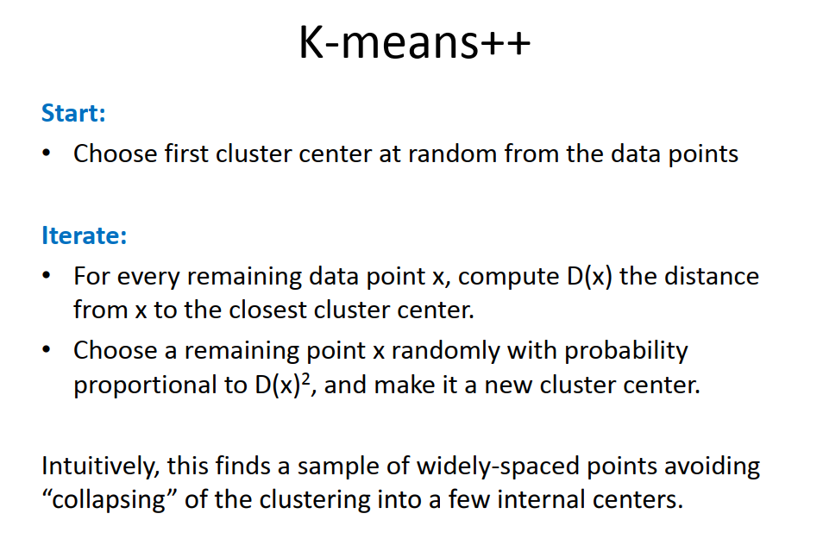

Slide 43
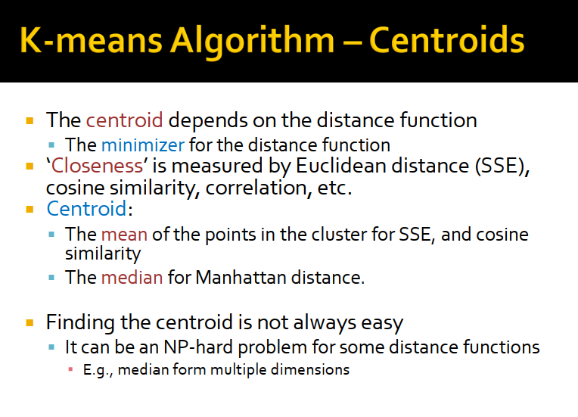

Slide 44
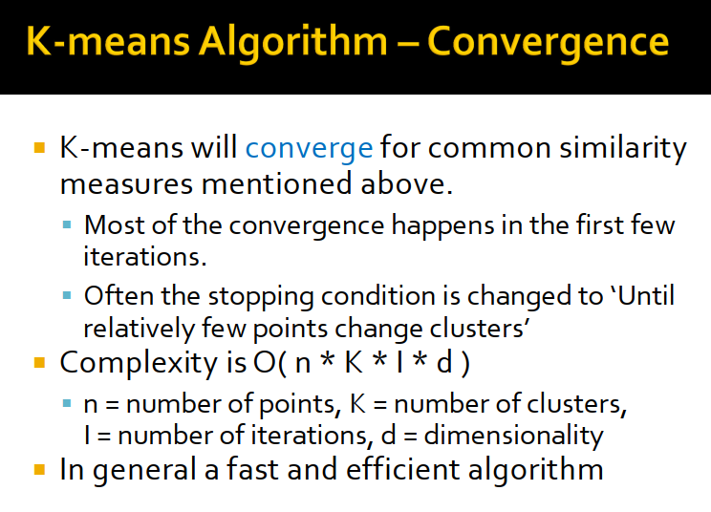

Slide 45
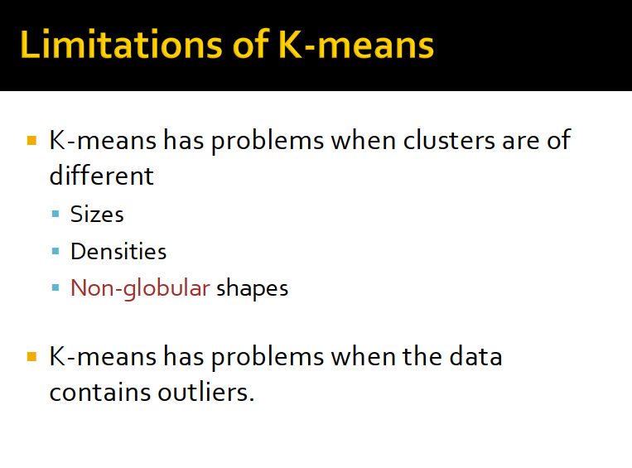

Slide 46
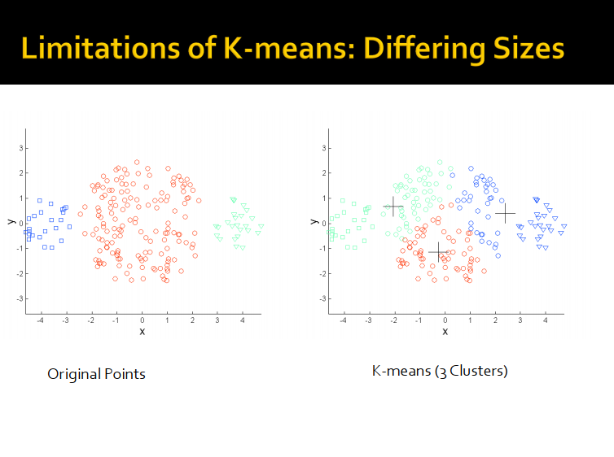

Slide 47
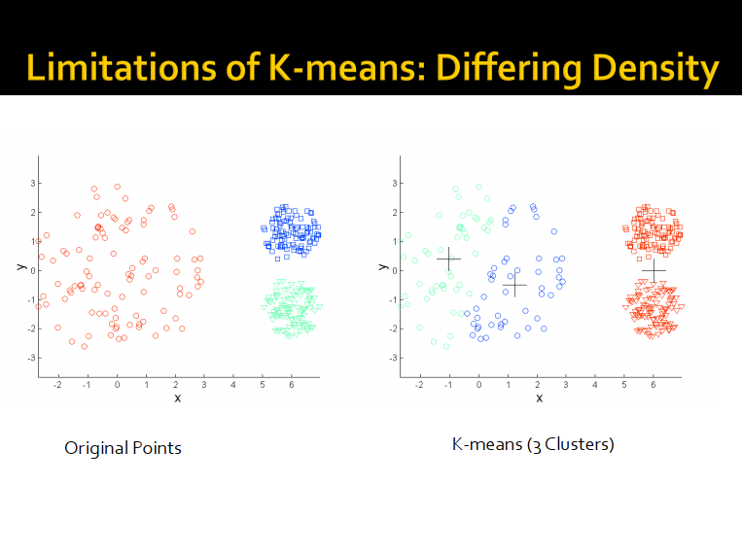

Slide 48
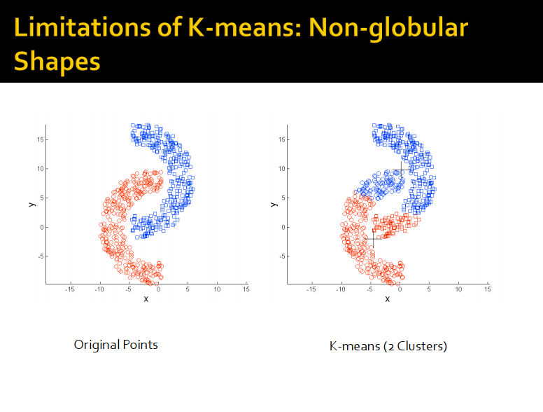

Slide 49
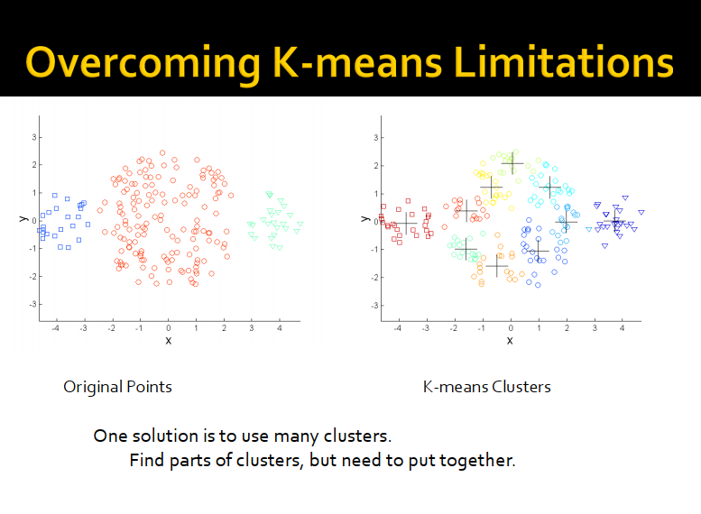

Slide 50
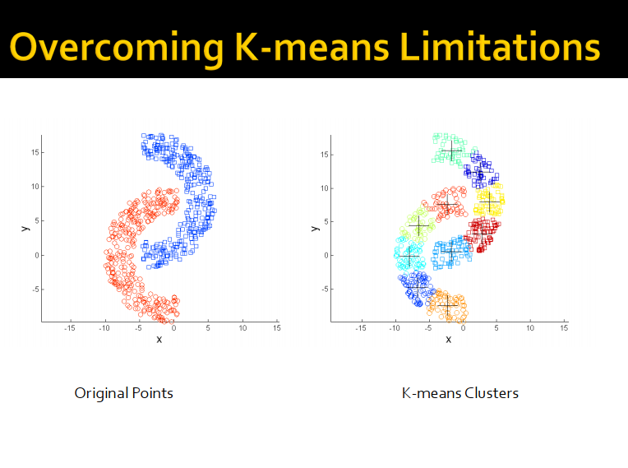

Slide 51
Silhouette
A method of interpretation and validation of clusters of data.
A succinct graphical representation of how well each data point lies within its cluster compared to other clusters.
a(i): average dissimilarity of i with all other points in the same cluster
b(i): the lowest average dissimilarity of i to other clusters

Slide 52
Silhouette

Slide 53

Comments on K-means
Pros
Simple and works well for regular disjoint clusters.
Converges relatively fast.
Relatively efficient and scalable O(t·k·n)
t: iteration; k: number of centroids; n: number of data points
Cons
Need to specify the value of K in advance.
Difficult and domain knowledge may help.
May converge to local optima.
In practice, try different initial centroids.
May be sensitive to noisy data and outliers.
Mean of data points …
Not suitable for clusters of
Non-convex shapes

Slide 54
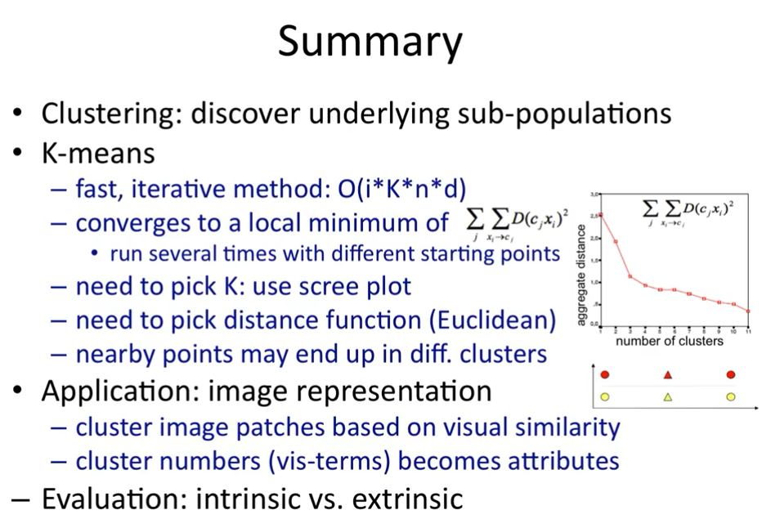

Slide 55
Variations of the K-Means Method
Most of the variants of the k-means which differ in
Selection of the initial k means
Dissimilarity calculations
Strategies to calculate cluster means
Handling categorical data: k-modes
Replacing means of clusters with modes
Using new dissimilarity measures to deal with categorical objects
Using a frequency-based method to update modes of clusters
A mixture of categorical and numerical data: k-prototype method

Slide 56
What is the Problem of the K-Means Method?
The k-means algorithm is sensitive to outliers !
Since an object with an extremely large value may substantially distort the distribution of the data
K-Medoids: Instead of taking the mean value of the object in a cluster as a reference point, medoids can be used, which is the most centrally located object in a cluster
10
10
9
9
8
8
7
7
6
6
5
5
4
4
3
3
2
2
1
1
0
0
1
2
3
4
5
6
7
8
9
10
0
0
1
2
3
4
5
6
7
8
9
10

Slide 57
PAM: A Typical K-Medoids Algorithm
Total Cost = 20
10
9
8
Arbitrary choose k object as initial medoids
Assign each remaining object to nearest medoids
7
6
5
4
3
2
1
0
0
1
2
3
4
5
6
7
8
9
10
K=2
Randomly select a nonmedoid object,O_{ramdom}
Total Cost = 26
Do loop
Until no change
10
10
9
Compute total cost of swapping
9
Swapping O and O_{ramdom}
If quality is improved.
8
8
7
7
6
6
5
5
4
4
3
3
2
2
1
1
0
0
1
2
3
4
5
6
7
8
9
10
0
0
1
2
3
4
5
6
7
8
9
10
57
Notes:
57

Slide 58
The K-Medoid Clustering Method
K-Medoids Clustering: Find representative objects (medoids) in clusters
PAM (Partitioning Around Medoids, Kaufmann & Rousseeuw 1987)
Starts from an initial set of medoids and iteratively replaces one of the medoids by one of the non-medoids if it improves the total distance of the resulting clustering
PAM works effectively for small data sets, but does not scale well for large data sets (due to the computational complexity)
Efficiency improvement on PAM
CLARA (Kaufmann & Rousseeuw, 1990): PAM on samples
CLARANS (Ng & Han, 1994): Randomized re-sampling

Slide 59
Hierarchical Clustering
Notes:
hierarchical英 [ˌhaɪəˈrɑ:kɪkl] 美 [ˌhaɪəˈrɑ:rkɪkl] adj.分层的;按等级划分的，等级（制度）的

Slide 60

Two main types of hierarchical clustering
Agglomerative:
Start with the points as individual clusters
At each step, merge the closest pair of clusters until only one cluster (or k clusters) left
Divisive:
Start with one, all-inclusive cluster
At each step, split a cluster until each cluster contains a point (or there are k clusters)
Traditional hierarchical algorithms use a similarity or distance matrix
Merge or split one cluster at a time

Slide 61
Produces a set of nested clusters organized as a hierarchical tree
Can be visualized as a dendrogram
A tree like diagram that records the sequences of
merges or splits
6
5
4
0.2
3
2
5
2
4
0.15
0.1
1
1
3
0.05
0
1
3
2
5
4
6

Slide 62
Do not have to assume any particular number of clusters
Any desired number of clusters can be obtained by ‘cutting’ the dendogram at the proper level
They may correspond to meaningful taxonomies
Example in biological sciences (e.g., animal kingdom, phylogeny reconstruction, …)

Slide 63
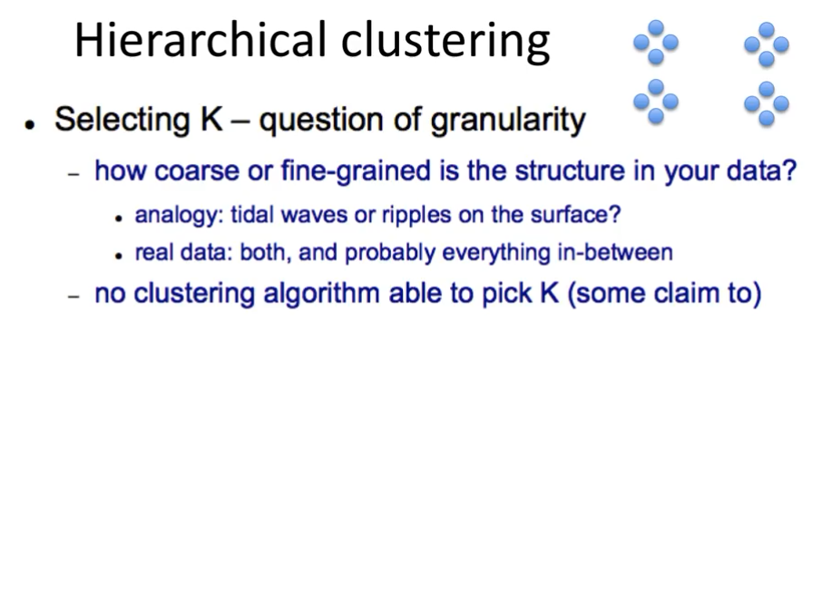
Notes:
coarse
英 [kɔ:s] 美 [kɔ:rs]
adj. 粗糙的;粗鄙的;粗野的;粗制滥造的
fine-grained英 [faɪn'greɪnd] 美 ['faɪn'greɪnd] adj.有细密纹理的
tidal waves
n. 潮汐波，浪潮( tidal wave的名词复数 )
ripple
英 [ˈrɪpl] 美 [ˈrɪpəl]
n.涟漪，涟波;[物]涟波;涟波声，潺潺声;（头发等的）波浪形

Slide 64
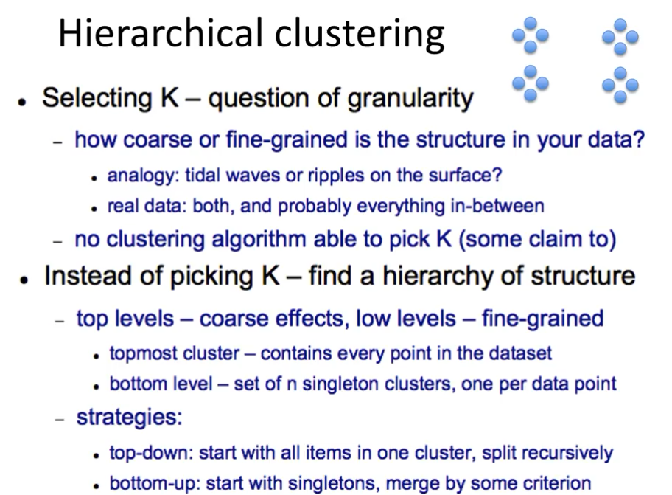

Slide 65
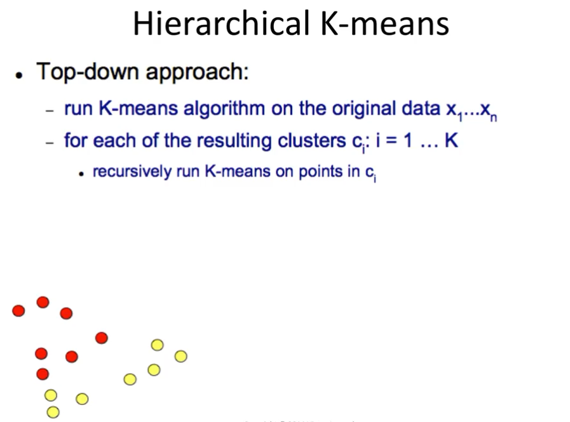

Slide 66
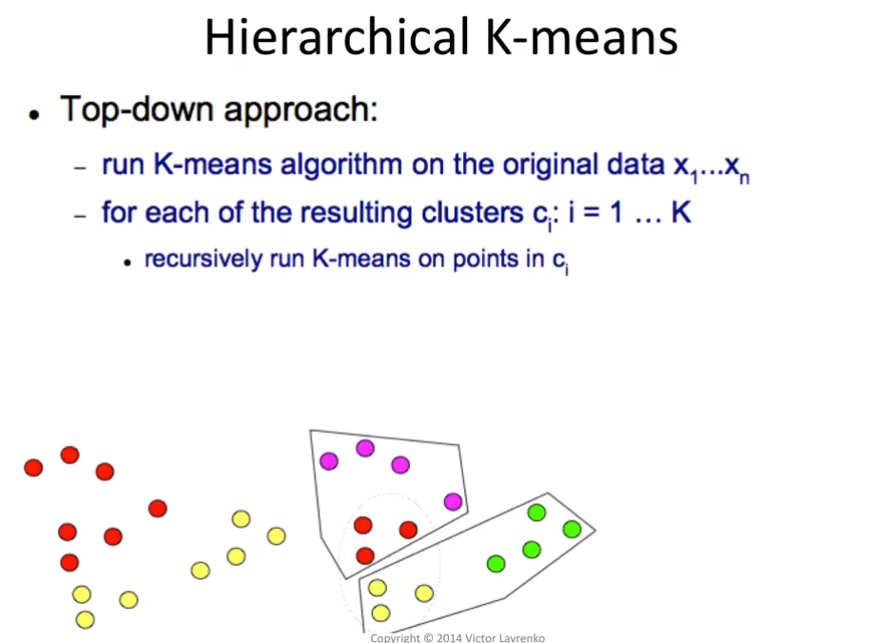

Slide 67
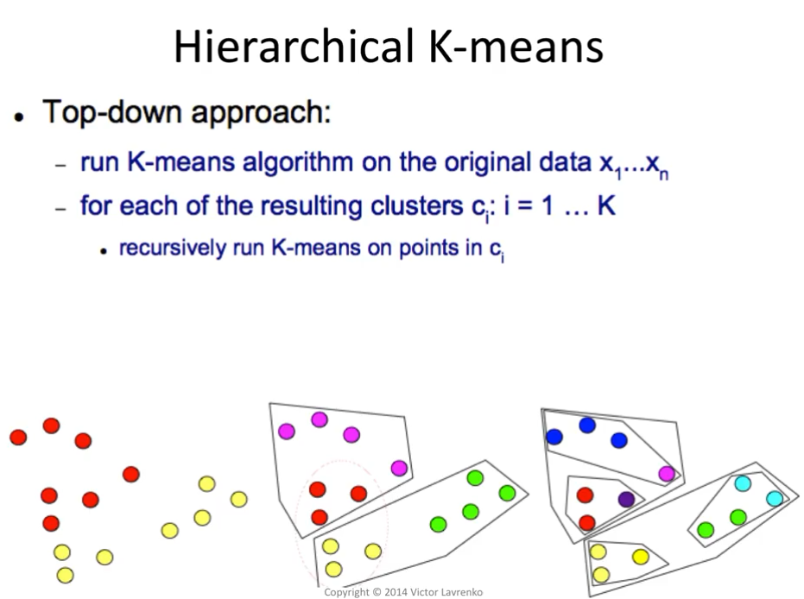

Slide 68
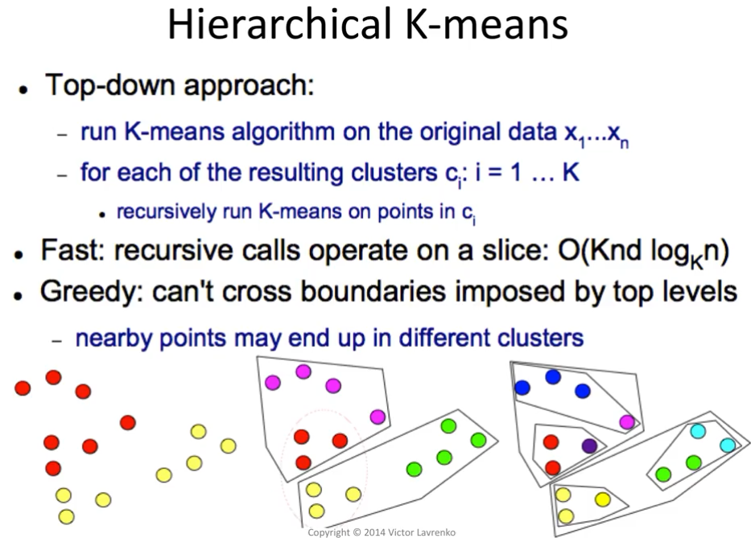

Slide 69
More popular hierarchical clustering technique
Basic algorithm is straightforward
Compute the proximity matrix
Let each data point be a cluster
Repeat
Merge the two closest clusters
Update the proximity matrix
Until only a single cluster remains
Key operation is the computation of the proximity of two clusters
Different approaches to defining the distance between clusters distinguish the different algorithms

Slide 70
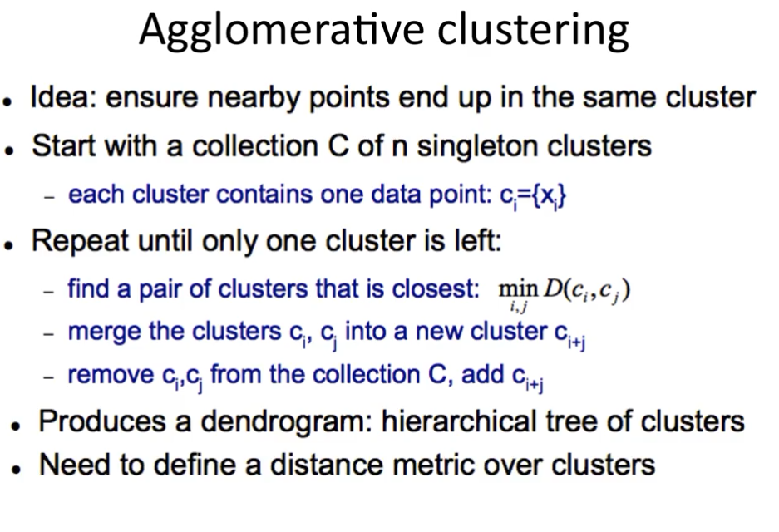
Notes:
dendrogram
英 ['dendrəgræm] 美 ['dendrəgræm]
n. 系统树图（一种表示亲缘关系的树状图解）

Slide 71
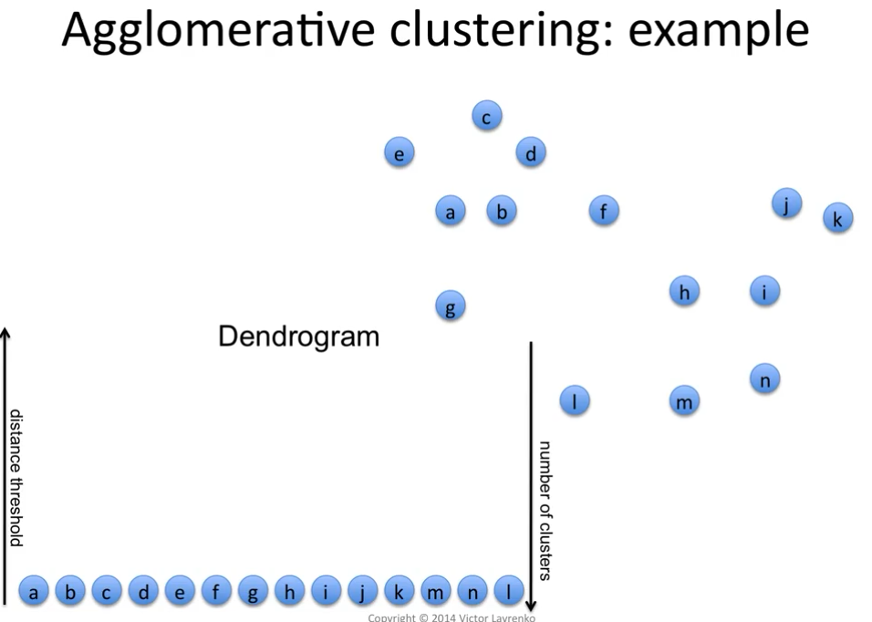

Slide 72


Slide 73


Slide 74


Slide 75


Slide 76


Slide 77


Slide 78


Slide 79


Slide 80


Slide 81


Slide 82


Slide 83


Slide 84


Slide 85


Slide 86

Agglomerative clustering: another example
 | BA | FI | MI | NA | RM | TO
BA | 0 | 662 | 877 | 255 | 412 | 996
FI | 662 | 0 | 295 | 468 | 268 | 400
MI | 877 | 295 | 0 | 754 | 564 | 138
NA | 255 | 468 | 754 | 0 | 219 | 869
RM | 412 | 268 | 564 | 219 | 0 | 669
TO | 996 | 400 | 138 | 869 | 669 | 0
Single Link

Slide 87
Agglomerative clustering: another example
 | BA | FI | MI/TO | NA | RM
BA | 0 | 662 | 877 | 255 | 412
FI | 662 | 0 | 295 | 468 | 268
MI/TO | 877 | 295 | 0 | 754 | 564
NA | 255 | 468 | 754 | 0 | 219
RM | 412 | 268 | 564 | 219 | 0
 | BA | FI | MI/TO | NA/RM
BA | 0 | 662 | 877 | 255
FI | 662 | 0 | 295 | 268
MI/TO | 877 | 295 | 0 | 564
NA/RM | 255 | 268 | 564 | 0

Slide 88

Agglomerative clustering: another example
 | BA/NA/RM | FI | MI/TO
BA/NA/RM | 0 | 268 | 564
FI | 268 | 0 | 295
MI/TO | 564 | 295 | 0
 | BA/FI/NA/RM | MI/TO
BA/FI/NA/RM | 0 | 295
MI/TO | 295 | 0

Slide 90
Notes:
dendrogram
英 ['dendrəgræm] 美 ['dendrəgræm]
n. 系统树图（一种表示亲缘关系的树状图解）

Slide 91


Slide 92

 | 1 | 2 | 3 | 4 | 5 | 6
1 | 0 | .24 | .22 | .37 | .34 | .23
2 | .24 | 0 | .15 | .20 | .14 | .25
3 | .22 | .15 | 0 | .15 | .28 | .11
4 | .37 | .20 | .15 | 0 | .29 | .22
5 | .34 | .14 | .28 | .29 | 0 | .39
6 | .23 | .25 | .11 | .22 | .39 | 0
5
1
3
5
2
1
2
3
6
4
0.2
4
0.15
0.1
0.05
Nested Clusters
Dendrogram
0
3
6
2
5
4
1

Slide 93



Original Points
Two Clusters
Can handle non-elliptical shapes
Notes:
elliptical英 [ɪˈlɪptɪkl] 美 [ɪˈlɪptɪkl] adj.椭圆的;省略的;像椭圆形的

Slide 94

Original Points
Two Clusters
Sensitive to noise and outliers

Slide 95


Slide 96

 | 1 | 2 | 3 | 4 | 5 | 6
1 | 0 | .24 | .22 | .37 | .34 | .23
2 | .24 | 0 | .15 | .20 | .14 | .25
3 | .22 | .15 | 0 | .15 | .28 | .11
4 | .37 | .20 | .15 | 0 | .29 | .22
5 | .34 | .14 | .28 | .29 | 0 | .39
6 | .23 | .25 | .11 | .22 | .39 | 0
4
1
2
5
5
2
3
6
3
1
0.4
4
0.35
0.3
0.25
0.2
0.15
Nested Clusters
Dendrogram
0.1
0.05
0
3
6
4
1
2
5

Slide 97



Original Points
Two Clusters
Less susceptible to noise and outliers

Slide 98


Original Points
Two Clusters
Tends to break large clusters
Biased towards globular clusters
Notes:
globular英 [ˈglɒbjələ(r)] 美 [ˈglɑ:bjələ(r)] adj.球形;球状的;球粒状

Slide 99


Slide 100

Proximity of two clusters is the average of pairwise proximity between points in the two clusters.
proximity(Cluster_{i} , Cluster_{j} ) =
Need to use average connectivity for scalability since total proximity favors large clusters
 | 1 | 2 | 3 | 4 | 5 | 6
1 | 0 | .24 | .22 | .37 | .34 | .23
2 | .24 | 0 | .15 | .20 | .14 | .25
3 | .22 | .15 | 0 | .15 | .28 | .11
4 | .37 | .20 | .15 | 0 | .29 | .22
5 | .34 | .14 | .28 | .29 | 0 | .39
6 | .23 | .25 | .11 | .22 | .39 | 0

Slide 101


 | 1 | 2 | 3 | 4 | 5 | 6
1 | 0 | .24 | .22 | .37 | .34 | .23
2 | .24 | 0 | .15 | .20 | .14 | .25
3 | .22 | .15 | 0 | .15 | .28 | .11
4 | .37 | .20 | .15 | 0 | .29 | .22
5 | .34 | .14 | .28 | .29 | 0 | .39
6 | .23 | .25 | .11 | .22 | .39 | 0
5
4
1
2
5
2
3
6
1
4
0.25
3
0.2
0.15
0.1
Nested Clusters
Dendrogram
0.05
0
3
6
4
1
2
5

Slide 102
Compromise between Single and Complete Link
Strengths
Less susceptible to noise and outliers
Limitations
Biased towards globular clusters
Notes:
globular英 [ˈglɒbjələ(r)] 美 [ˈglɑ:bjələ(r)] adj.球形;球状的;球粒状

Slide 103


Slide 104


Slide 105
Similarity of two clusters is based on the increase in squared error (SSE) when two clusters are merged
Similar to group average (average link) if distance between points is distance squared
Less susceptible to noise and outliers
Biased towards globular clusters
Hierarchical analogue of K-means
Can be used to initialize K-means

Slide 106




1
5
4
1
3
2
5
5
2
5
1
MIN
MAX
2
2
3
6
3
3
6
1
4
4
4
1
5
5
4
1
2
2
5
2
Ward’s Method
5
2
3
6
Group Average
3
6
3
1
1
4
4
4
3

Slide 107


Slide 108


Slide 109


Slide 110



Slide 111


Slide 112

Simple Hierarchical Agglomerative Clustering

Slide 113


Efficient Hierarchical Agglomerative Clustering

Slide 114


Single-link clustering algorithm using an NBM array

Slide 115
Agglomerative clustering: time complexity
Naïve implementation of hierarchical clustering:
At each step, compute pairwise distances between all pairs of clusters, then merge
O(N³)
Careful implementation using priority queue can reduce time to O(N² log N)
Still too expensive for really big datasets that do not fit in memory

Slide 116

Computational complexity in time and space
Once a decision is made to combine two clusters, it cannot be undone
No objective function is directly minimized
Different schemes have problems with one or more of the following:
Sensitivity to noise and outliers
Difficulty handling different sized clusters and convex shapes
Breaking large clusters

